Slide 1
Trebuchet Launch Project
Prepared by -
Declan Day, Anna Liu, Jana Mosko, Irving Zhang
April 15th 2025
Notes:
Hi everyone this is the presentation for our trebuchet launch project.

Slide 2
Content
Introduction
The System of Equations and Approach
Calculation
Notes:
This fis the content we need to cover today, the introduction of the machine, the system of equations and their approach, and the possible calculations.

Slide 3
Introduction
How the trebuchet works.
Assumptions:
The sling arm ADB is a massless rigid beam.
friction is negligible, because in such a small system and in such a short time what friction there is cannot affect the values enough to factor into the equations.
The final state is when the counterweight hits the ground because it cannot provide any more potential energy to the system.
The ground is considered to have zero potential energy.
Notes:
First, let me introduce our assumptions for the problem

Slide 4
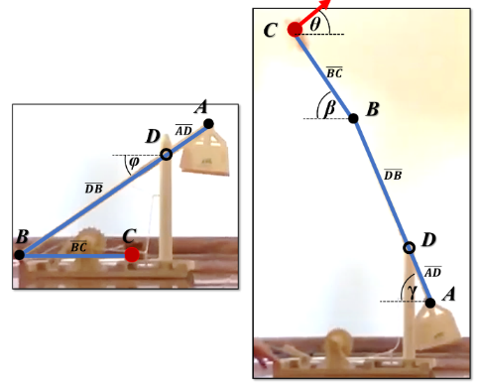
How the trebuchet works.

Slide 5
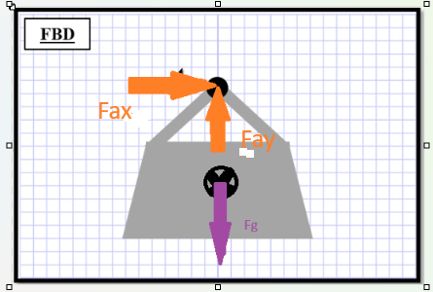
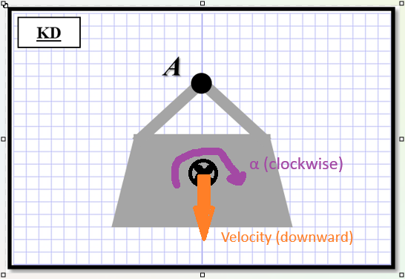
How the trebuchet works.
Counterweight Box
Notes:
Then, this is how the machine works.

Slide 6
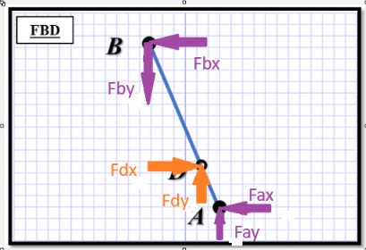
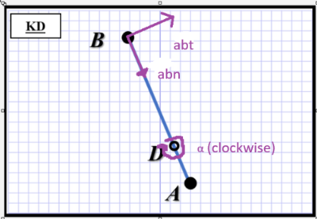
Sling Arm

Slide 7
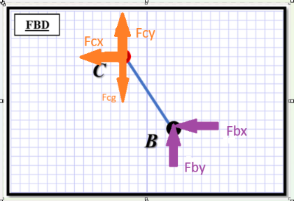
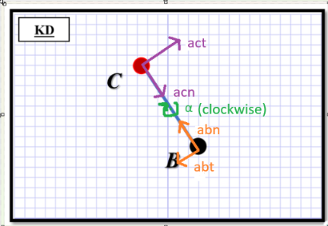
Swing Arm

Slide 8
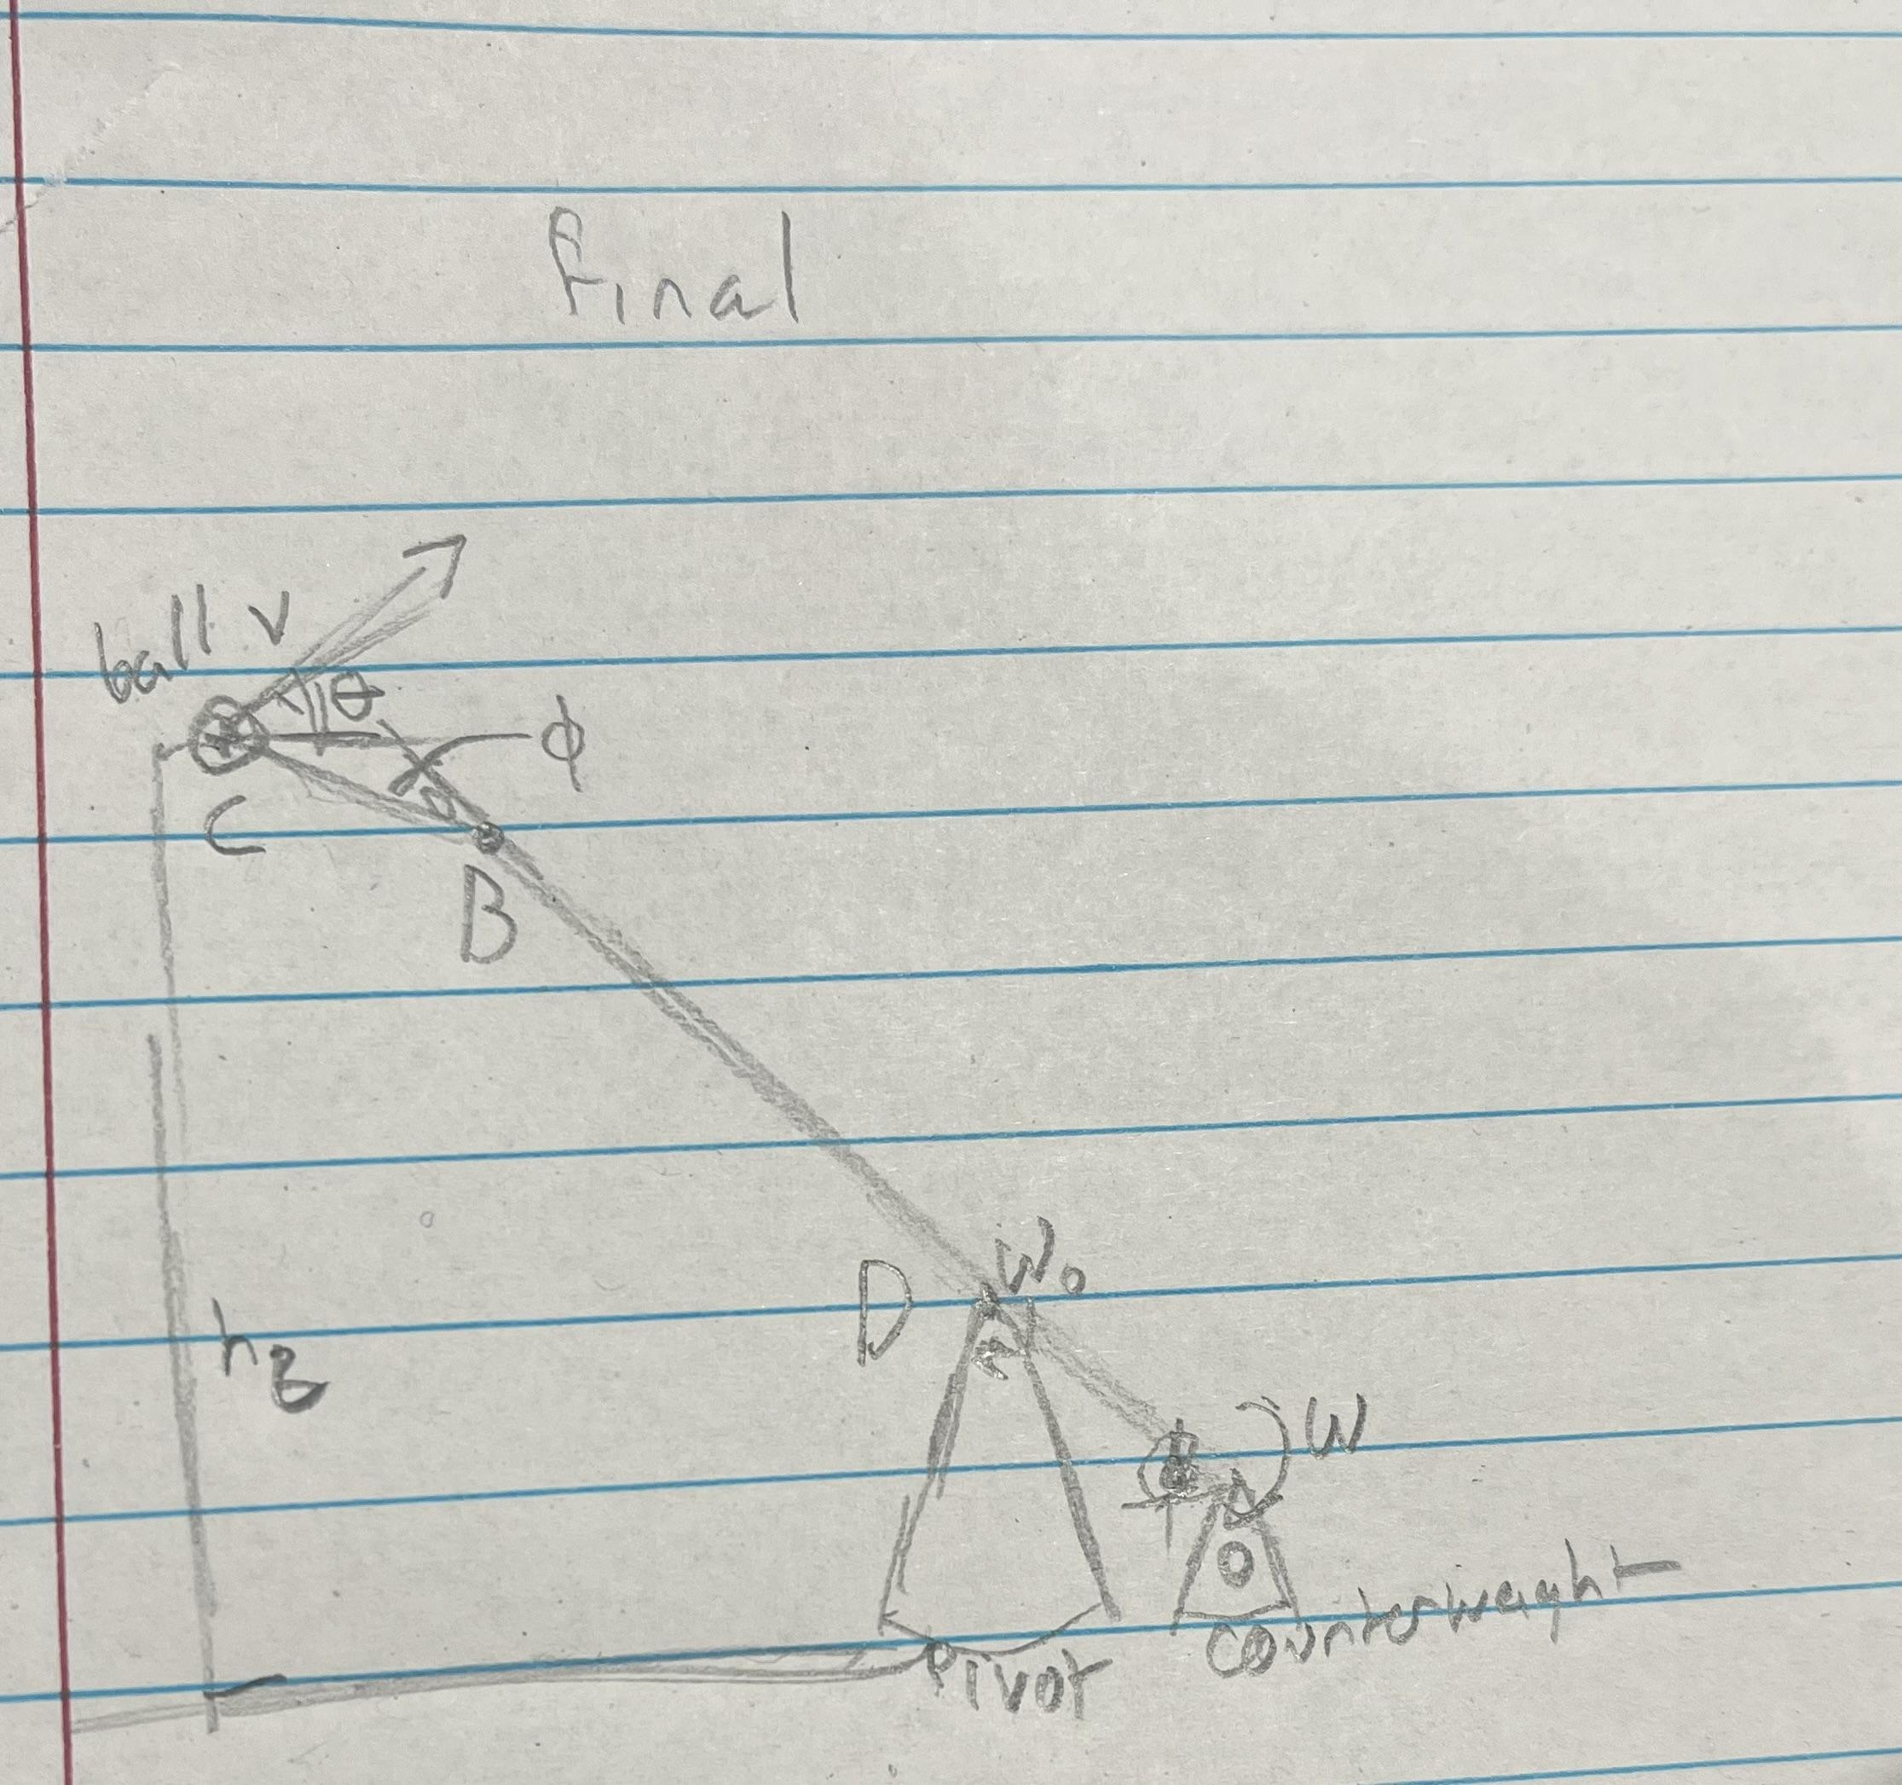
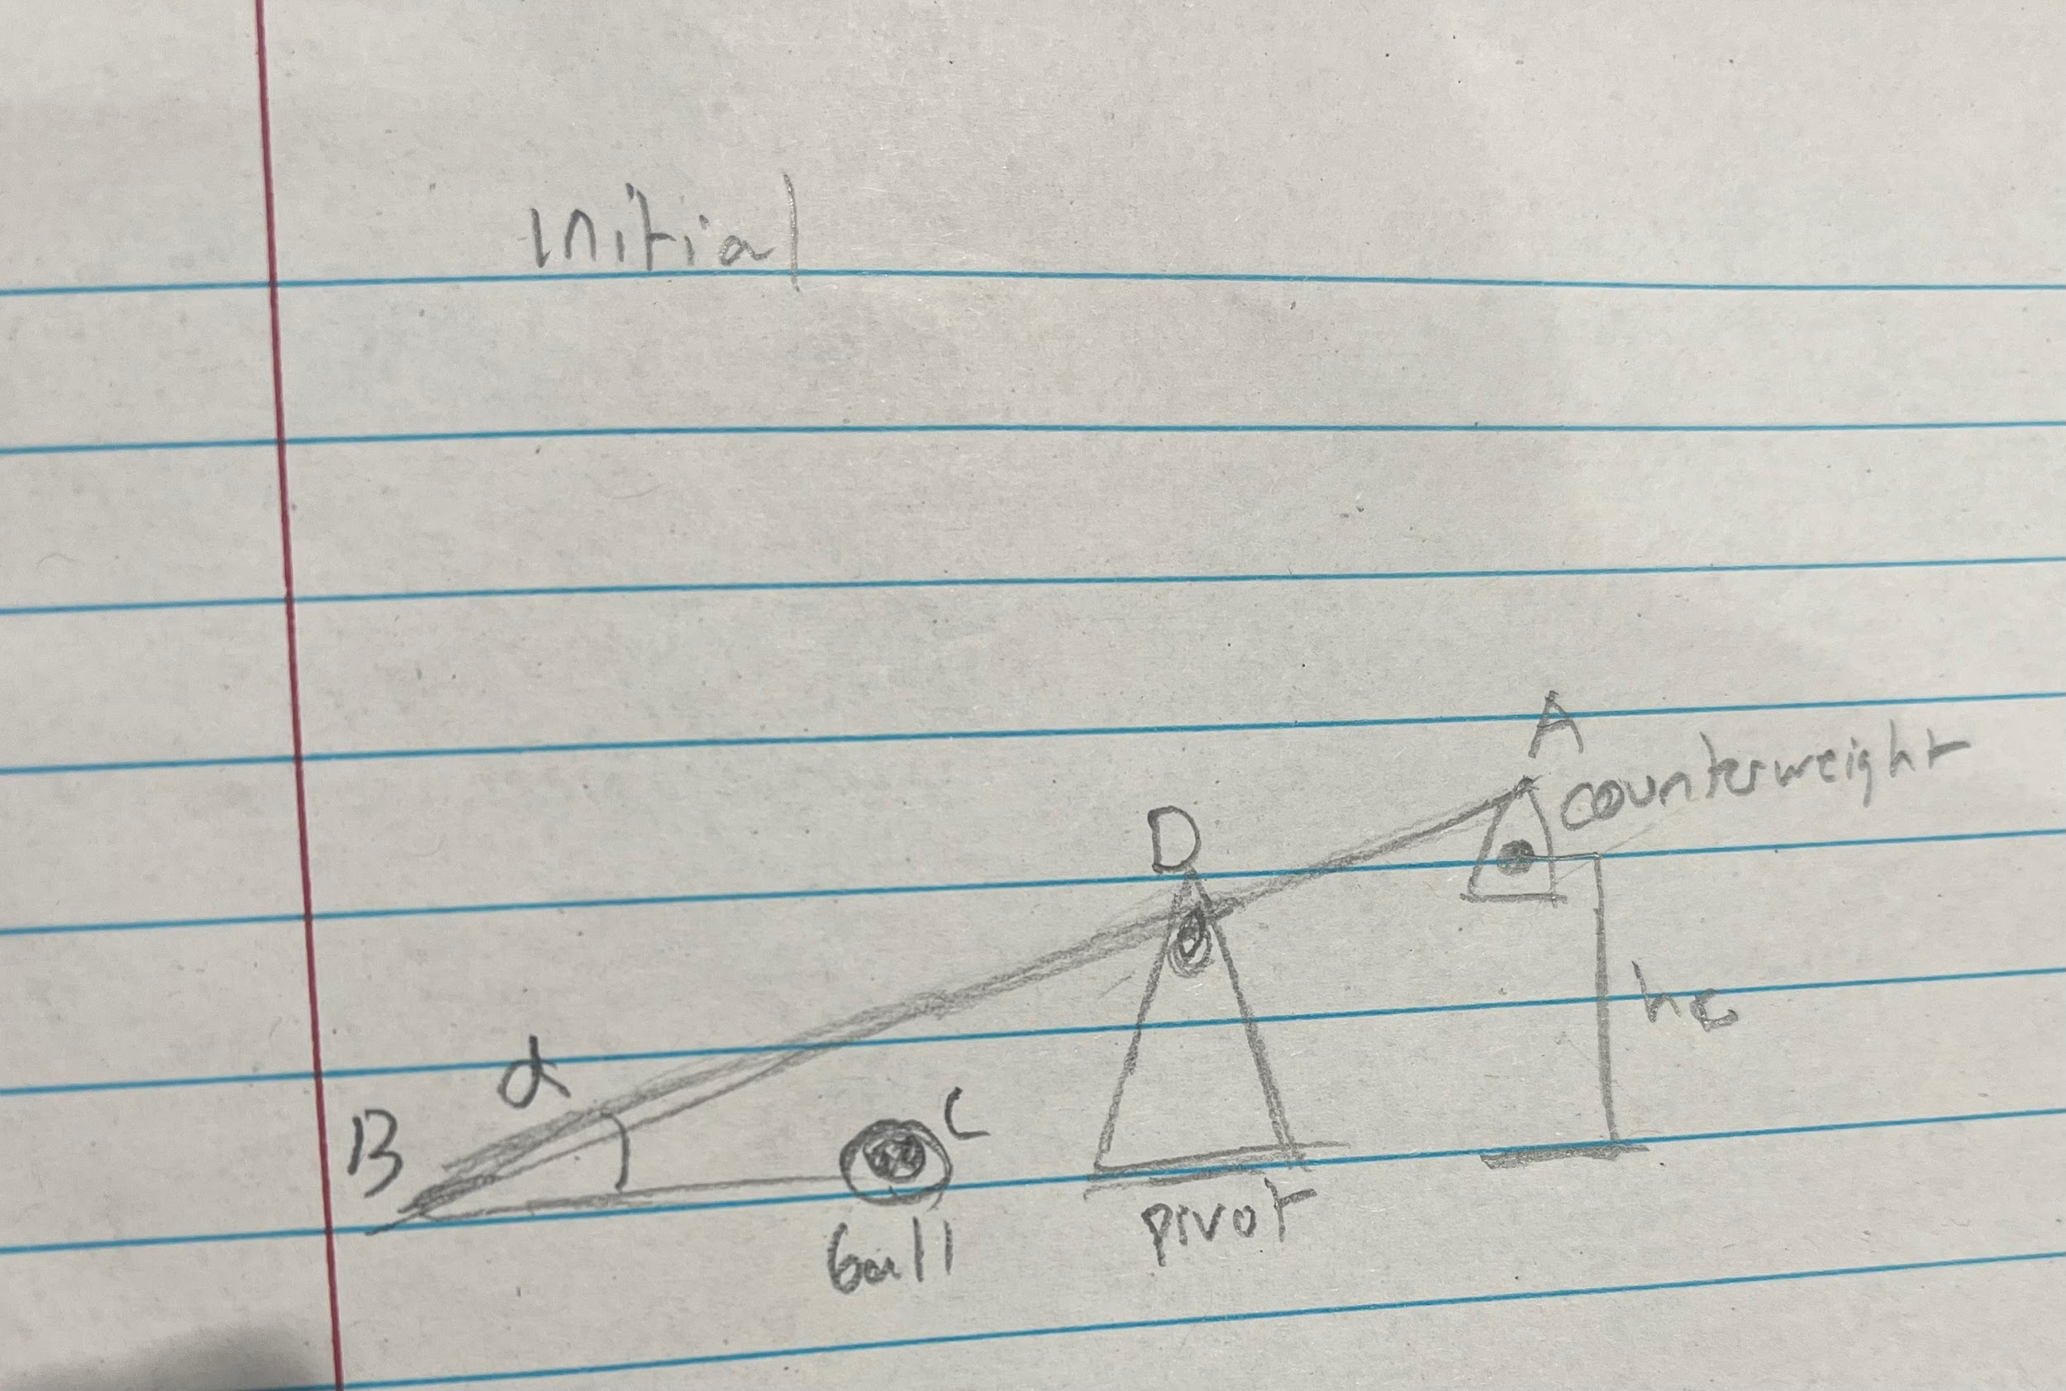
Work-Energy Diagrams

Slide 9
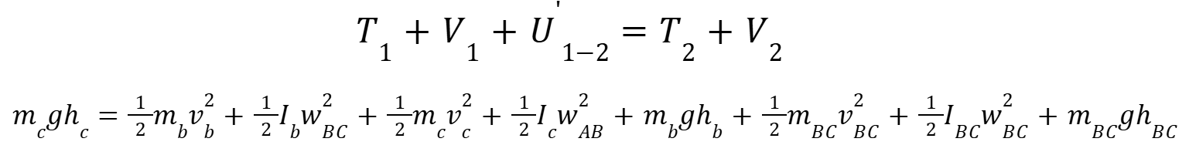
The System of Equations and Approach
Work-Energy Approach:
Notes:
The counterweight is in pure clockwise rotation by beam AD, the axis of rotation is not on the body but the point D.
Kinetic energy of clay ball, counterweight
Potential energy of clay ball
Kinetic energy of swing arm BC, potential energy
The clay ball is in translation and clockwise rotation by beam BC, and the axis of rotation is not on the COM of the body but on point B.

Slide 10
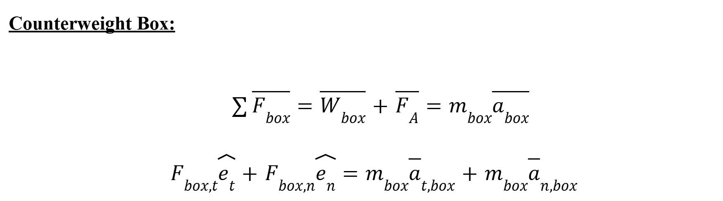
Newton’s 2nd Law Approach:

Slide 11
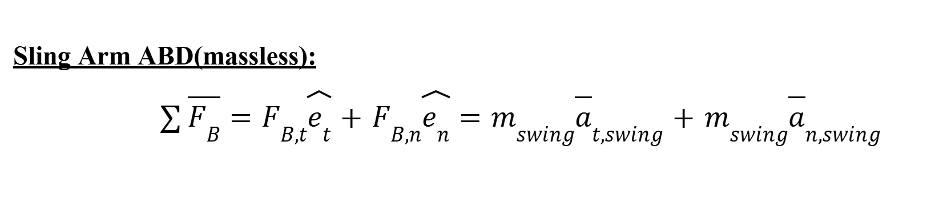
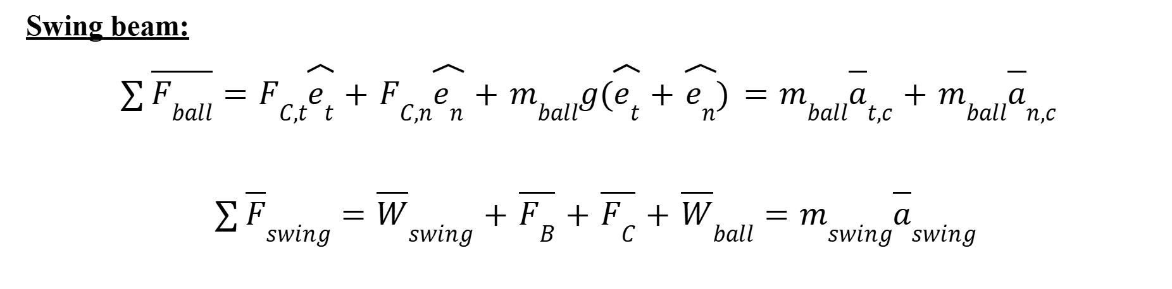

Slide 12
Calculation
determine the mass of the counterweight box necessary to reach the target.
Known:
***Trebuchet Dimensions:
Swing Arm: 0.480m length; 0.100 width/thickness; 35g mass of arm (assume it is a single wooden beam)
Sling Arm: 0.260m length; (assume there is a sphere on the end of massless beam)
Sphere: 0.023m diameter; 10g mass of clay ball
Counterweight Box: 0.070m distance from COM to axis of rotation (A); 32g mass of box

Slide 13
Calculation

